Slide 1
Overview of Services

Slide 2
Brain Development
The brain develops most rapidly between ages birth to three
At birth, brain cells are not connected - stimulation encourages connections
The brain of a sixth month old child is already ½ its adult weight, 9/10 by age 5 yrs
The brain is more flexible early on

Slide 3
Available Services
Occupational Therapy
Physical Therapy
Developmental Therapy
Speech Therapy
Audiology
Nutrition
Social Work
Family Education
Vision Services
Nursing Services
Diagnostic Medical Services
Psychological
Assistive Tech.
Transportation

Slide 4
Overview
Federal and State funded program
Family centered & community based (natural environment)
Birth to 3 years
Experiencing a delay
Medical diagnosis
High probability of delay
Cost Participation

Slide 5
Referral Process
Anyone can refer a child
Referral made to the System Point of Entry (SPOE)
Family is contacted
Intake meeting set
Notes:
Parent, doc, daycare provider - anyone can make a referral; family has right to decline
Every region has a System Point of Entry (SPOE); where process begins; where records are maintained
Family contacted within 2 business days. May take slightly longer in some smaller counties.

Slide 6
Evaluation & Assessment
Family is assigned a Service Coordinator to discuss child’s needs
Assessment Team Therapists are assigned to family and evaluate each child in their home or other setting
Assessment tool (AEPS), medical records and clinical opinion are used to determine eligibility

Slide 7
IFSP Development
Team meeting
Family’s goals/concerns
Therapy outcomes
Therapy location
Transition
Therapy in the “Natural Environment”

Slide 8
Service Coordination
Ongoing case manager
Coordinates all agencies involved
Assists family with red tape
Works with family the entire time child is in First Steps

Slide 9
What does First Steps service delivery look like?
Natural environment
Developing strategies that families can use in their homes and as a part of their routine

Slide 10
What does First Steps service delivery look like?
Working as a team with the family and other therapists

Slide 11
What does First Steps service delivery look like?
Forming strong relationships with families while sharing your expertise

Slide 12
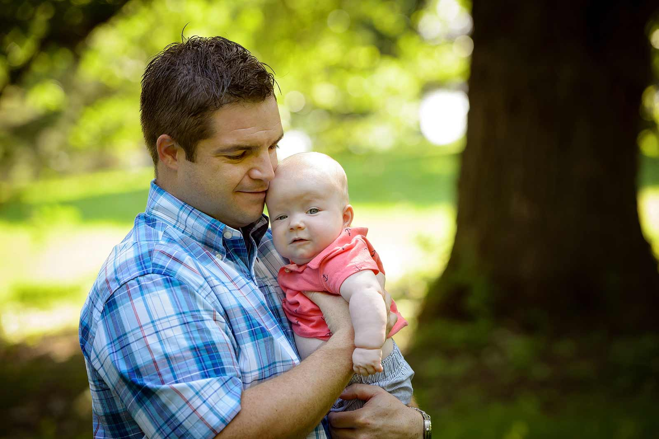
What does First Steps service delivery look like?
Having the opportunity to learn from and work alongside culturally diverse populations

Slide 13
What does First Steps service delivery look like?
Assisting in the child’s development during the formative years

Slide 14
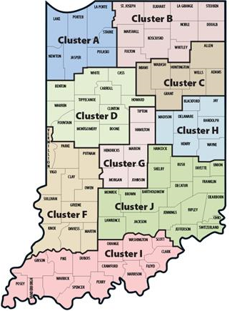
County Clusters
Counties grouped together with neighboring counties to share and maximized resources
One SPOE in each cluster
9 Clusters throughout the state
Central Indiana Cluster includes
Hamilton, Hendricks, Johnson, Marion, Morgan, and Tipton Counties

Slide 15
Other Resources
LPCC participation open to families and community members
Website – www.cibaby.org (Central Indiana) or www.firststeps.in.gov (State)

Slide 16
First Steps Early Intervention Program
Questions?

