Slide 1
Become a First Steps Provider

Slide 2
Overview
Federal and State funded program
Family centered & community based (natural environment)
Birth to 3 years
Experiencing a delay
Medical diagnosis
High probability of delay
Cost Participation

Slide 3
Available Services
Occupational Therapy
Physical Therapy
Developmental Therapy
Speech Therapy
Audiology
Nutrition
Social Work
Family Education
Vision Services
Nursing Services
Diagnostic Medical Services
Psychological
Assistive Tech.
Transportation

Slide 4
Referral Process
Anyone can refer a child
Referral made to the System Point of Entry (SPOE)
Family is contacted
Intake meeting set
Notes:
Parent, doc, daycare provider - anyone can make a referral; family has right to decline
Every region has a System Point of Entry (SPOE); where process begins; where records are maintained
Family contacted within 2 business days. May take slightly longer in some smaller counties.

Slide 5
Evaluation & Assessment
Family is assigned a Service Coordinator to discuss child’s needs
Assessment Team Therapists are assigned to family and evaluate each child in their home or other setting
Assessment tool (AEPS), medical records and clinical opinion are used to determine eligibility

Slide 6
IFSP Development
Team meeting
Family’s goals/concerns
Therapy outcomes
Therapy location
Transition
Therapy in the “Natural Environment”

Slide 7
Service Coordination
Ongoing case manager
Coordinates all agencies involved
Assists family with red tape
Works with family the entire time child is in First Steps

Slide 8
What does First Steps service delivery look like?
Natural environment
Developing strategies that families can use in their homes and as a part of their routine

Slide 9
What does First Steps service delivery look like?
Working as a team with the family and other therapists

Slide 10
What does First Steps service delivery look like?
Forming strong relationships with families while sharing your expertise

Slide 11
What does First Steps service delivery look like?
Having the opportunity to learn from and work alongside culturally diverse populations

Slide 12
What does First Steps service delivery look like?
Assisting in the child’s development during the formative years

Slide 13
Why Choose First Steps?
Impact a young child’s development utilizing the skills you learned in school
Work alongside families using a coaching model
Empower families in their natural environment
Multidisciplinary Teams/Co-treatments
Ongoing Professional Development
Work with toddlers and babies!!
Notes:
Empower families to use resources in their homes and community environments to meet developmental milestones

Slide 14
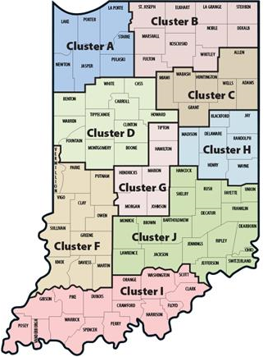
Employment Opportunities
Regional job opportunities
State approved provider agencies
Enrollment assistance
Specialty service agencies
Independent providers
Full or part-time opportunities
Set your own schedule and service area

Slide 15
Questions?
Katarina Groves, Council Coordinator
Central Indiana First Steps
kgroves@cibaby.org
317-472-6109
FSSA: First Steps: First Steps Offices (in.gov)

